Slide 1

Year 13 Information Evening
The John Fisher School

Slide 2
Agenda
Introduction & Expectations
The Year Ahead / Key Dates / Assessments
Study habits / organisation
The UCAS Process
Apprenticeships
Opportunities for Questions

Slide 3
Aims
All Students should have the following targets for the end of the year:
Leave with Maximum Qualifications
Leave with a clear idea of their next steps
(University / Apprenticeship / Employment)

Slide 4
What is needed to succeed?
Get organised. Use time well and create good habits.
High expectations, Don’t settle for good enough, insist on your best!
Pre-reading / Flipped learning
Accept the advice and help offered.
Go above and beyond! Review, Redraft - Resubmit

Slide 5
Organisation & Study
A Year Plan with key dates
Plan your work load and Build routines
Know your syllabus
Use study periods effectively
Make your notes now!
Limit hours of paid work

Slide 6
Use your time well
Make the best use of Study Periods and time in school
Recognise your environment
Set Clear Goals
Read widely

Slide 7
Supporting your son at home
Exam boards
  AQA
  OCR
  Edexcel
  WJEC
What to look for
  Past Papers
  Mark Schemes
  Examiners Reports/comments
  Exemplar materials
How he should spend his time
  Notes with textbooks
  Wider reading
  Regular Quizzing
  Practice papers
  Re-submissions
  Documentaries
  Lectures
  Revision activities

Slide 8
Key Dates
Assessment & Reporting
15th October Oxbridge, Medical /Vet/ UCAS
October Feedback from In Class Assessment
30th November (2 Weeks) Pre Public Examinations 1
21st January Year 13 Parent Teacher Meeting
22nd March Pre Public Examinations 2
April Developmental Targets

Slide 9
Contacts
Director of Sixth Form – Mr B Woolford: b.woolford@johnfisherschool.org
Assistant Director of Sixth Form – Mr M Webb- M.Webb@johnfisherschool.org
Attendance & Sixth Form Administrator & Pastoral Care - Mrs C. Cooney k.cooney@johnfisherschool.org

Slide 10
The School Day
The arrangements for the school have had to be updated as a response to Coronavirus pandemic. In line with government guidelines, the school has put in place to minimise the mixing of students and to ensure social distancing can be maintained. This has resulted in a change to the Sixth Form school day as well as the spaces available to Sixth Form Students.
Entry point: Students will enter the school site via the Pedestrian Gate
Holding area / play space: Students can spend break time in the Sixth Form Centre.
Lining up: Year 13 Students will be asked to line up in their transition area outside the Sixth Form
Entry / Exit Point: Students will be asked to enter via the Back entrance of Founders
Teaching Area: All lessons will be timetabled in a either the Founders Block or Sixth Form Centre.
Dismissal time: 3.25pm (except on Wednesdays for those at Plough Lane - 3.25pm) to reduce social contact outside of school.
Dismissal point: Students will be asked to leave via the Pedestrian Gate

Slide 11
The School Day
Form Until 9.05 | Period 1 9.10 -10.00 | Break 10.05 -10.25 | Period 2 10.25 -11.15 | Period 3 11.15 -12.05 | Lunch 12.05 - 12.45 | Period 4 12.45 -13.35 | Period 5 13.40 -14.30 | Period 6 14.35 -15.25

Slide 12
Absences
Planned Absences
If a student is unable to attend school due to a medical appointment or valid reason this should be communicated and agreed in advance where possible. Requests for permission for the absence should be communicated to Mrs Cooney
If you are unable to attend school due to unforeseen circumstances this must be reported to Mrs Cooney before 10.00 am each day of the absence, this may be done via email k.cooney@johnfisherschool.org or on 020 8660 4555 and leaving a message.
Absences should not be reported by the student, the school remain In Loco parentis regardless of age and we will always ask your parent / carer to report the absences themselves even if the student is over 18.
In some instances, it may be appropriate for us to send work home where absence may be prolonged. For us to do this, we do need to be kept well informed by the student and home throughout a prolonged illness.
The parents / carer of any student with an unexplained absence will be contacted via text on by 10.30, please ensure that we have an accurate up to date mobile number
Coronavirus
Please note, if a student is displaying the designated symptoms (As set by the UK Government) for coronavirus, then they are not to attend school, self isolate and apply for a test. If a student or a member of their household tests positive for coronavirus, then the student is expected acquire a test as soon as possible and to self isolate for the required time

Slide 13
Catering
The provisional plans are that there will be no breakfast items available and food can only be purchased at lunch but not during break time. Parents/carer will only have 2 meal deal options for their sons which will either be a meat or vegetarian sandwich (this is for students across year groups and staff members). The menu and the system will be reviewed.

Slide 14
Sixth Form Dress Code
Sixth Formers should take pride in their school and themselves. They should look smart and presentable at all times. Students should dress in full uniform. Students have a choice which can be made from the following:
Black blazer with the school logo worn with smart black trousers (no chinos)
Tailored trouser only: no chinos, jeans, leggings or stretched trousers
Collared white shirt
Full-length school neck tie
Optional jumper or cardigan in a fine weave (plain, v neck, no sweatshirt material)
Black or brown sensible, formal shoes. No trainers or boots
Hoodies are not permitted. Jumpers with logos may not be worn
Coats, hats and scarves must be removed on entering the school buildings.
Jewellery related to sincere religious observance may be worn.
Any nasal or other facial piercing must be removed
Students may have facial hair, but it should be kempt.
All students should remain in uniform all day including study periods.
No extreme hairstyles are permitted in terms of cut or colour.
The final decision in relation to the Dress Code rests with a member of the Sixth Form team

Slide 15
Health and Support
Health and Support
A counselling service is available to all students in the Sixth Form. If something is worrying you, no matter how small, and it is upsetting the balance in your life, a chat with your tutor or a member of the Sixth Form team may be all you need by way of support and to get things back on track.
If your troubles are more worrying than that; you are feeling vulnerable or unsafe, or are worried about your mental health and wellbeing, you can speak to the Sixth Form Team who can help organise support either within the school or via external agencies. You can also make use of the Time to Talk box, found in the Sixth Form Centre.
Further information can be found below:
Chat Health – contraception, smoke stop, alcohol, bereavement, mental health etc. Text: 07480635511
Relationships, drugs, money, mental health – www.themix.org.uk
Mental health – https://youngminds.org.uk
Mental health including suicide – www.samaritans.org
Mental health app – https://www.headspace.com
Mental health – www.thecalmzone.net
Self harm – www.nshn.co.uk
Eating disorders – https://beateatingdisorders.org.uk
The school nurse runs drop-in sessions offering advice and support for all physical and mental health issues. Please speak to the Sixth Form team to book an appointment.

Slide 16
Working together
Sixth Form Team
Regular Monitoring
Early intervention / Pastoral care
Exam technique & Study skills
Home
Stay connected (SMH/ email / Texts )
Take an interest
Encourage discussion
Communication and Partnership
Enrichment of Individuals

Slide 17
Predicted grades
Students will be given the highest grade from the following for their UCAS Prediction:
ALPs Target Grade (Based upon the Average Point Score of GCSE Results).
Result of In Class Assessment.
Professional Prediction.
For students not applying to these specific courses, we ask that all applications are received by the end of the winter term. This means students will have the opportunity to sit their November PPE exams to help inform their predicted grades.
For students not applying in October the following system will be applied:
Students will be given the highest grade from the following for their UCAS Grade:
ALPs Target Grade (Based upon the Average Point Score of GCSE Results).
Result of PPE.
Professional Prediction.
Whilst we wish to ensure that our UCAS predicted grades are in the best interests of applicants, we must clarify that these grades are aspirational. As such, in the event that the school is asked to submit Centre Assessed Grades through evidence of student performance, they will do so using the evidence of student performance available, in line with government guidance. Please also note that if a UCAS grade is based solely upon an ALPs target grade, the student may be working below this level and may not achieve their UCAS prediction, either in an exam or in a Centre Assessment Grading system. Therefore, we would encourage students to apply to a range of institutions with differing entry criteria.

Slide 18
Potential Pathways
UNIVERSITY IN SEPT 2021
GAP YEAR THEN UNIVERSITY IN SEPT 2021
APPRENTICESHIP
SCHOOL LEAVER PROGRAMME
FURTHER STUDIES
PAID EMPLOYMENT

Slide 19
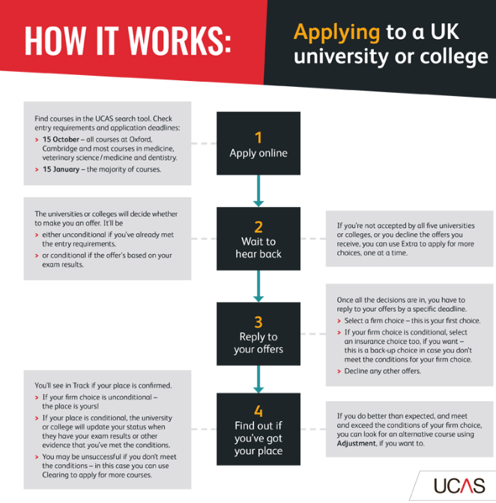

Applying to University via UCAS

Slide 20
The Basics
University applications are made through UCAS
Students have 5 course choices which are made on one online form
The closing date is 15th January (15th October for Oxford/Cambridge and medicine)
Students may be called for interview but most will not
Decisions are made by Universities from September to April
Places are conditional on obtaining exam grades
One firm and one insurance offer to accept in late April
If no offers students can choose another option through UCAS Extra.
If still not placed or do not meet the conditions of an offer, you can enter Clearing. This starts from 8am on Results Day.

Slide 21
The UCAS Process
Choose a course
Choose a University
Register for the relevant admissions tests
Submit UCAS application by October/Januar/March
Result of application
Interviews take place in December/January
Submit written work if required, and sit tests in November
Begin
course at
Oxford!
Choose ‘firm’ and ‘insurance’ choices
Exam results/ confirmation

Slide 22
Step 1: Searching for courses and providers
Extended Project Qualification | GCE & VCE AS Levels | GCE & VCE A Levels | Tariff | BTEC (QCF) Extended Diploma | BTEC (QCF) Diploma | BTEC (QCF) Subsidiary Diploma | BTEC (QCF) Certificate
 |  |  | 168 | D*D*D*
 |  |  | 160 | D*D*D
 |  |  | 152 | D*DD
 |  |  | 144 | DDD
 |  |  | 128 | DDM
 |  |  | 112 | DMM | D*D*
 |  |  | 104 |  | D*D
 |  |  | 96 | MMM | DD
 |  |  | 80 | MMP | DM
 |  |  | 64 | MPP | MM
 |  | A* | 56 |  |  | D*
 |  | A | 48 | PPP | MP | D
 |  | B | 40
 |  | C | 32 |  | PP | M
A* |  |  | 28 |  |  |  | D*
A |  | D | 24 |  |  |  | D
B | A |  | 20
C | B | E | 16 |  |  | P | M
D | C |  | 12
 | D |  | 10
E |  |  | 8 |  |  |  | P
 | E |  | 6
Firstly deciding what type of undergraduate course to study.
The main application deadlines are in October, January, and March, depending on the course.
Up to five courses can be chosen, to increase the chance of getting a place.

Slide 23
Step 2: Finding your favourites
You should apply for courses both slightly above and below your predicted grades.
1 Safe, 2 Aspirational and 2 Solid.
What factors might affect your choices?
Aspiration vs Realism
Geography
Reputation
Atmosphere?
What do you want to achieve from University?
If you are predicted ABB you could apply for courses requiring AAB – BBB.
However, do not to apply for courses that are well above your predicted grades – they are wasted choices.

Slide 24
Step 3: Filling out your profile
Cost– completing and submitting your application by the relevant application deadline. For 2020-21 entry, the application fee is £20 for a single choice, or £26 for more than one choice.
You can only apply once
Complete Personal Details and Education History
Make sure you know your exam boards to GCSEs and A levels
Strong applications may be assessed on:
Content of written personal statement displaying passion for the subject area, while demonstrating motivation, enthusiasm, and the skills and experiences that will enable you to succeed at university.
Quality and content of reference.
Knowledge of and commitment to the subject discipline.
Good attitude to learning and personal development.
Ability to articulate yourself fluently and accurately in writing

Slide 25

Step 4: Sending your application
If you’re applying through a school or college, they’ll be able to complete your reference and send us your application once you’ve paid for it.
Check your details are correct.

Slide 26

Step 5 Responding to offers
You'll be able to sign in at any time with the Personal ID in your welcome email, along with the password you used when applying.
Offers – wait to see if any of your university/college choices offer you an interview or a place on their course.
Replies – these are the responses you make to the offers you get.
Results – confirmation of an offer might depend on your exam results.

Slide 27
Apprenticeships: The Basics
Apprenticeships mix on-the-job training with classroom learning.
They provide you with the skills you need for your chosen career that will also lead to nationally recognised qualifications.
As an apprentice you earn while you learn and receive other benefits as well.

Slide 28
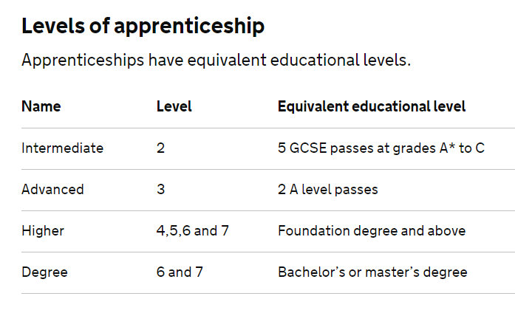
Levels of Apprenticeships

Slide 29
Why an Apprenticeship
Higher Apprenticeships are a great alternative to university.
On- and off-the-job training.
A salary
The opportunity to really start moving your career forward.
No student debts
Build Contact.

Slide 30
Why an Apprenticeship
Apprenticeships are available in 170 industries covering over 1500 job roles. There are up to 2,700 jobs vacancies across England right now on the apprenticeships.gov.uk website right now.
Employers think that apprentices are 15% more employable than those with other qualifications.
Some 87% of graduating apprentices from the last 10 years are still working within the business, 38% promoted at least once, demonstrating how the apprenticeship program strengthens our workforce capabilities and provides business leaders.

Slide 31
What is available
Business / Finance & IT,
Construction,
Creative media & the arts,
Customer service & retail,
Energy, Engineering & electrical,
Health & care,
Hospitality & travel,
Manufacturing,

Slide 32

Who Is Involved
SERVICES AND RETAIL
DHL
Greene King
Greggs
Hilton Worldwide
Royal Mail
Superdrug and Savers (AS Watson)
BUSINESS
Barclays
Deloitte
JP Morgan
Lloyds Banking Group
M&G Investments
Nationwide
PwC
TSB
SCIENCE, TECHNOLOGY, ENGINEERING, MATHS
Atkins
BAE Systems
Barratt Developments PLC
National Grid
Network Rail
COMMUNICATIONS AND MEDIA
BT
Capgemini
Cisco
Fujitsu
Tangerine PR
GOVERNMENT AND THE PUBLIC SECTOR
Army
BBC
FCO Services
Royal Air Force
St Mungo’s Broadway

Slide 33
What To Do Next
Research
What Level
What Sector
Which Provider
What is the application process
When are the deadlines

Slide 34
Apprenticeships
https://www.ucas.com/file/120301/download?token=DPdwJ0EV
http://amazingapprenticeships.com/resources/which-complete-guide-to-higher-and-degree-apprenticeships/
https://www.gov.uk/government/publications/higher-and-degree-apprenticeships
https://www.milkround.com/school-leavers
http://www.allaboutschoolleavers.co.uk/
https://www.thetechpartnership.com/recruit-and-train/tig-apprenticeships/
https://www.getingofar.gov.uk/
https://www.getmyfirstjob.co.uk/
http://www.apprenticeshipguide.co.uk/
https://www.prospects.ac.uk/
http://www.studentladder.co.uk/School-Leaver-Programmes/school-leaver-programmes.html
https://www.notgoingtouni.co.uk/apprenticeships

Slide 35
Questions

