Slide 1

Year 8 Information Evening
Thursday 2nd October 2025
The John Fisher School

Slide 2
Who will you hear from?
Head of Year 8
Science
Maths
RE
English

Slide 3
Year 8 Team
8B Mr Keh
8C Mr Greenwood
8K Mrs Mukesh
8M Mrs Naidoo
8N Mrs Bibi
8T Mrs Murden
KS3 Administrator Mrs Maynard
Head of Year Mr Dawkins
Deputy Headteacher Mrs Lovelock

Slide 4
Form Time
Monday: Current Affairs (Newsround and or Weekly Quiz)
Tuesday: Year Assembly
Wednesday: Morning Prayer
Thursday: Literacy
Friday: Celebrating success

Slide 5


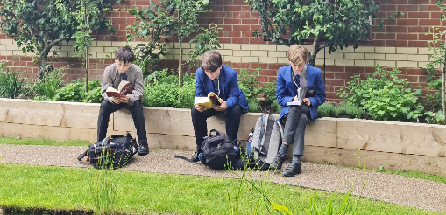

Year 8 Literacy Overview and Reading Expectations
Year 8s should always have a ‘reading book’ of their choice and interest on the go. This could be a book from home or a book checked out from the LRC.
Dedicated lesson in the LRC once a fortnight where a love of reading is fostered through independent reading time; they are held to account on logging what they have read/learnt in their Reading Logs.
Form Time Literacy Programme: One form time a week that is dedicated to reading as class. This term is based on a pastoral collection of fiction extracts and non-fiction articles focused on school values.

Slide 6


…and open every break Mon.-Thurs.!

Slide 7

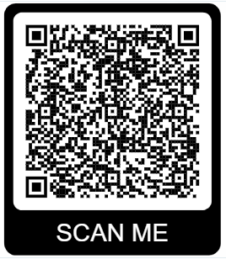
Supporting reading at home
The benefits of independent reading are numerous – please find a variety of materials available on our school website:
A parent guide to engaging your child in reading
A selection of reading recommendations and book lists

Slide 8

Wellbeing Support
Your first point of contact should always be the form tutor. They know your son best and will know who to contact to ensure the right support is put in place.
Your son should feel able to talk to any responsible adult they trust about anything. We tell them this and we ask that you do to.
safeguarding@johnfisherschool.org

Slide 9
Mental Health
We are part of the Sutton schools Mental Health Cluster, sharing best practice.
We have staff trained Mental Health First aiders (pink lanyards).
Mental Health wellbeing practitioner on site two days a week.
Range of intervention and support for students; last year these included sleep and anxiety, revision and managing exam stress
Parental workshops throughout the year, advertised in the Headteacher’s newsletter.
Contact with any concerns on wellbeingsupport@johnfishersupport.org
Inclusion officer is Ms Lala

Slide 10
Key Dates for Year 8
Interim monitoring: End of Autumn Term
Interim monitoring: End of Spring Term
Parent/Teacher Evening: 23rd April 2026
Interim Monitoring: End of Summer Term

Slide 11
Streaming
Your son will sit assessments in all his subjects.
In English, Maths, Science, History, Geography, RE and ICT there is a streamed set. The way this is calculated is as follows:
All the assessments in the above subjects are taken and the lowest score is removed.
An average of that score is then calculated.
The score is then ranked (1-90 as there are two sides to the year X and Y)
The top 30 scoring students are in the streamed sets and the others are distributed between the remaining 2 sets. There are no ‘bottom’ sets.

Slide 12
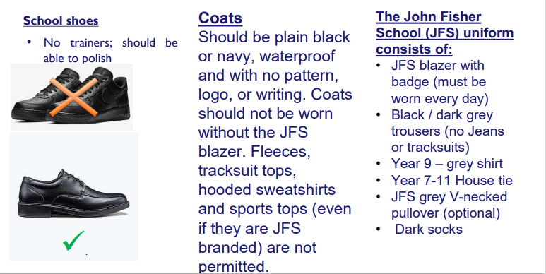
Uniform

Slide 13
School Attendance – The law
The law entitles every child of compulsory age to an efficient, full-time education suitable to their age, aptitude, and any special educational need they may have. It is the legal responsibility of every parent/carer to make sure their child receives that education by attendance at a school.
Parents/carers have an additional legal duty to ensure their child attends school regularly. This mean their child must attend every day that the school is open, except in a small number of allowable circumstances such as being too ill to attend.

Slide 14
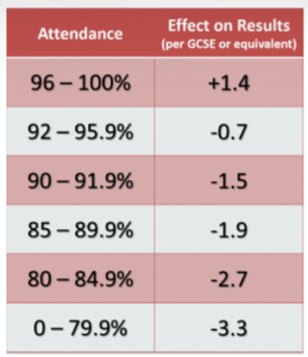
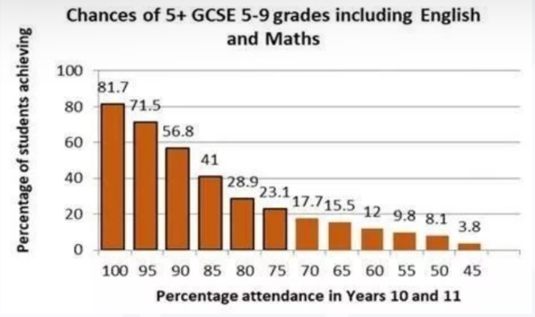
Impact of absences

Slide 15
Behaviour Focus
Same day detentions:
2 demerits- 20 minutes
3 demerits- 40 minutes
4 demerits or a subject removal – 60 minutes (missed 60 minutes will be escalated to BSR)
On-call removals – BSR (3 hours minimum)
Late to lessons will also be added up and time served at the end of the detention.
Late to school detentions and Saturday detentions will resume soon.

Slide 16
Bromcom
• By now you should have been sent the log in details for Bromcom. Please download and log
in as soon as possible as this is where you can find all behaviour details. Edulink doesn’t
work for us anymore.
• Students have been set up in ICT lessons – this will be continuing along with support from
IT
• Any questions please see us at the end

Slide 17
Home school partnership
Community
School
Child
Home
When we work together your son will benefit.
We are not beyond reproach but please challenge appropriately.

Slide 18
Core Subject Presentations
The John Fisher School

Slide 19
Science

Slide 20
Teaching Staff: Fully staffed with Qualified Science Teachers
Biology Specialists:
Ms Mozammel (SL for Biology)
Mr Bennett (Dept Head)
Mrs Thaker
Ms Bryant
Chemistry Specialists:
Mrs Woolcock (SL for Science)
Mr Hall (SL for Chemistry)
Miss Green
Ms Bryant
Physics Specialists:
Mr Harwood (SL for Physics)
Dr Ekanayake
Ms Bryant
Mr Hassan

Slide 21
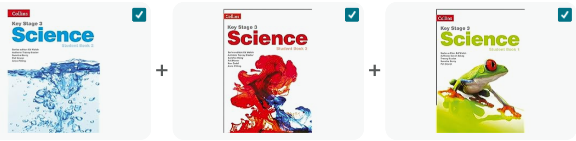
Our KS3 Curriculum is support by the Collins KS3 Schemes of work
There are supporting materials on the Year 8 Science Google Classroom

Slide 22
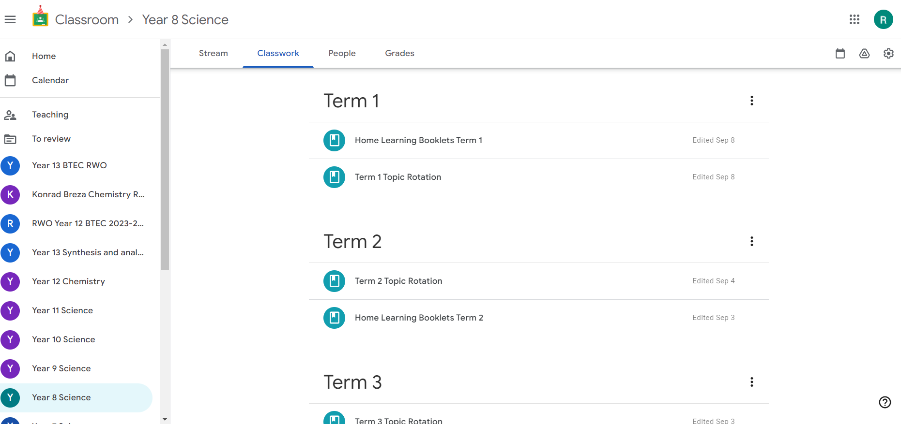
Google Classroom
Class Code: 2qxn7nw
An invite will be sent via an online platform
Your son needs to join to access his home learning booklets

Slide 23

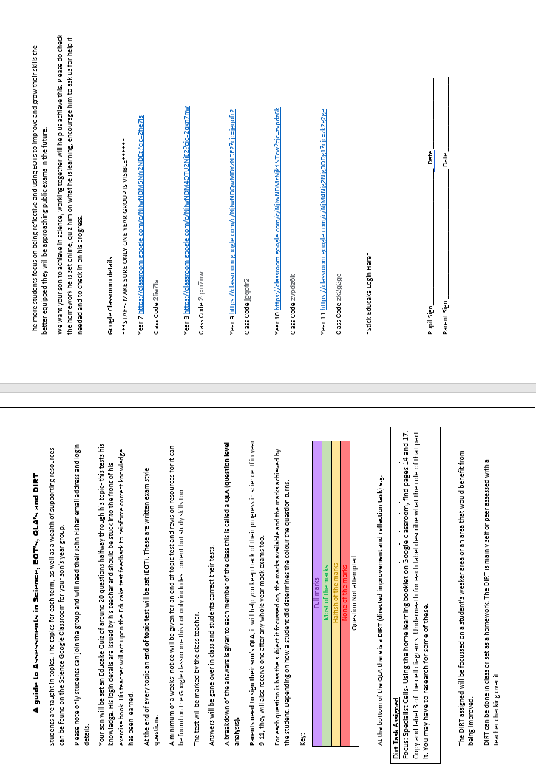
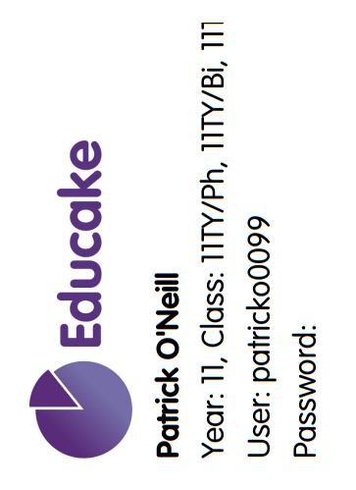
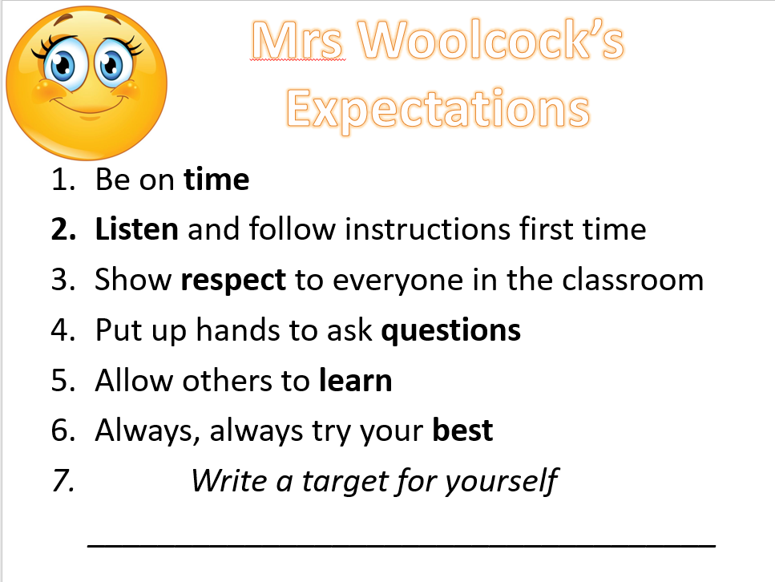
Educake
Login details for Google Classroom and Educake can be found at the front of your son’s exercise book.
Years 7-9 will have a lesson with a laptop to ensure they can login.

Slide 24
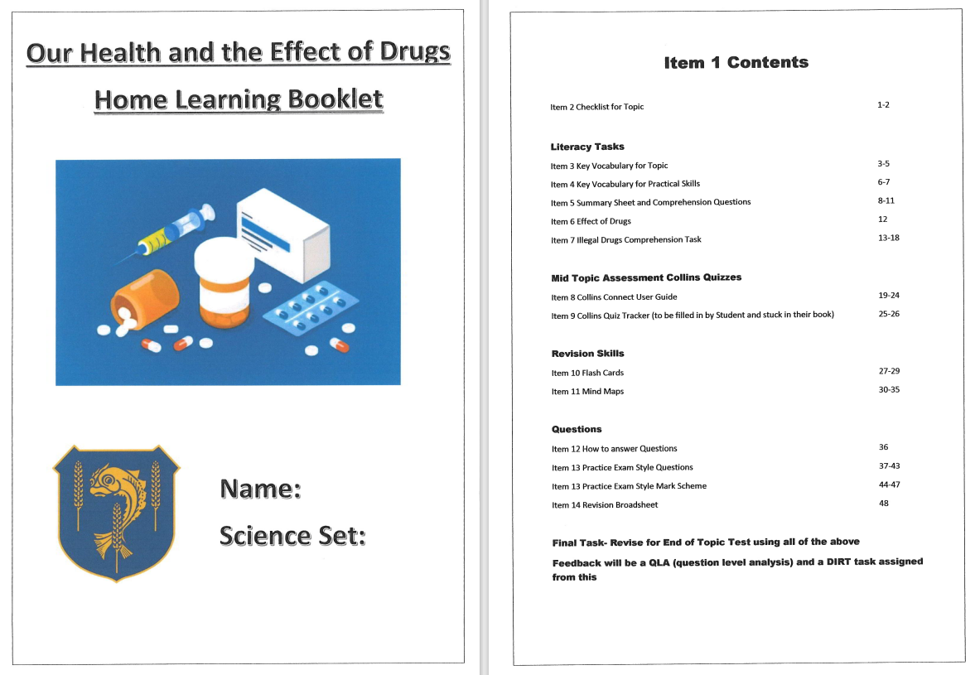
Home learning Booklets
Each Topic has a Home Learning Booklet
Your son will be set homework from this
They also contain revision tips, additional tasks to boost learning and understanding that can be self assessed.

Slide 25
Assessment
Topic checklist issued with specific information and knowledge for that particular topic
Mid-point of a topic low stakes quiz on Educake are set and feedback available to students.
End of topic- end of topic assessment, marked by the teachers and personalised feedback and DIRT (directed improvement and reflection time) task produced.

Slide 26
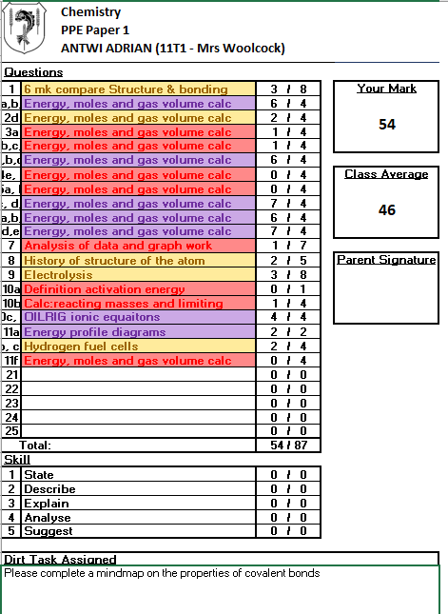
End of Topic Assessment
He will be given a feedback sheet that will be stuck at the back of the book and that we ask you to sign.
He will also be given an improvement task to complete
Topic X
Student A
10Ty

Slide 27
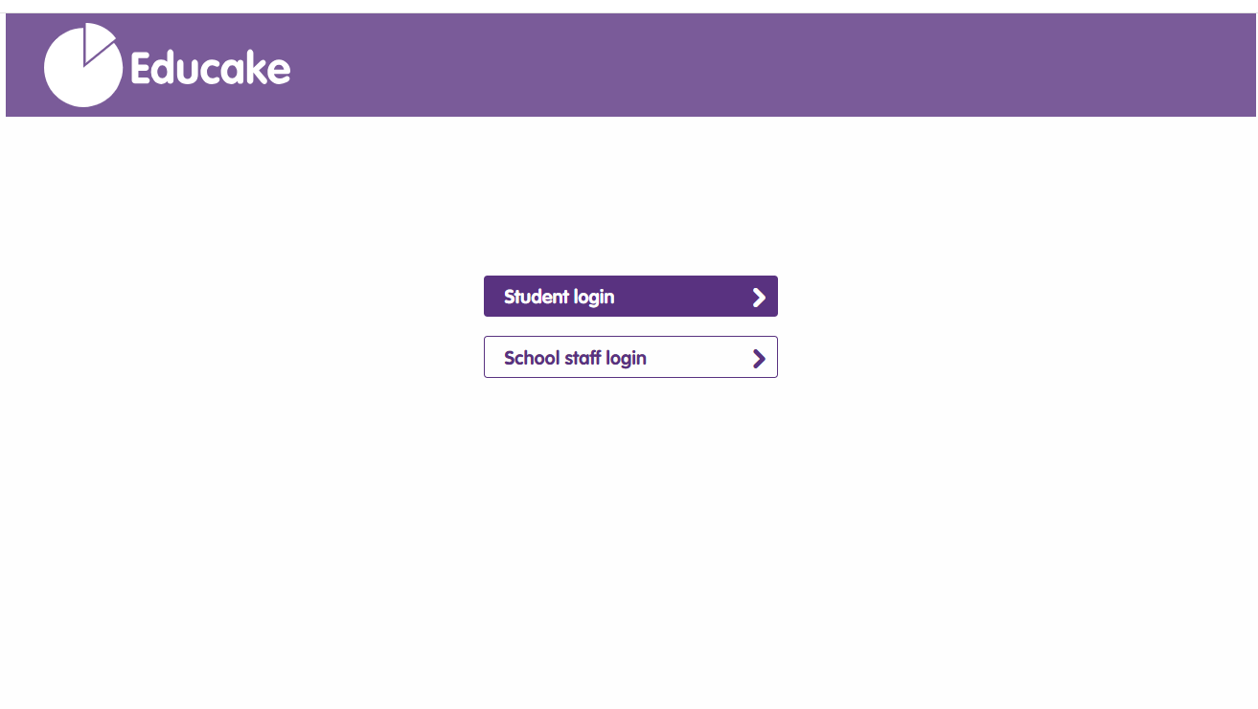
Educake: Our online low stakes Quizzes
Google ‘Educake, select students then enter details (front of exercise book)

Slide 28
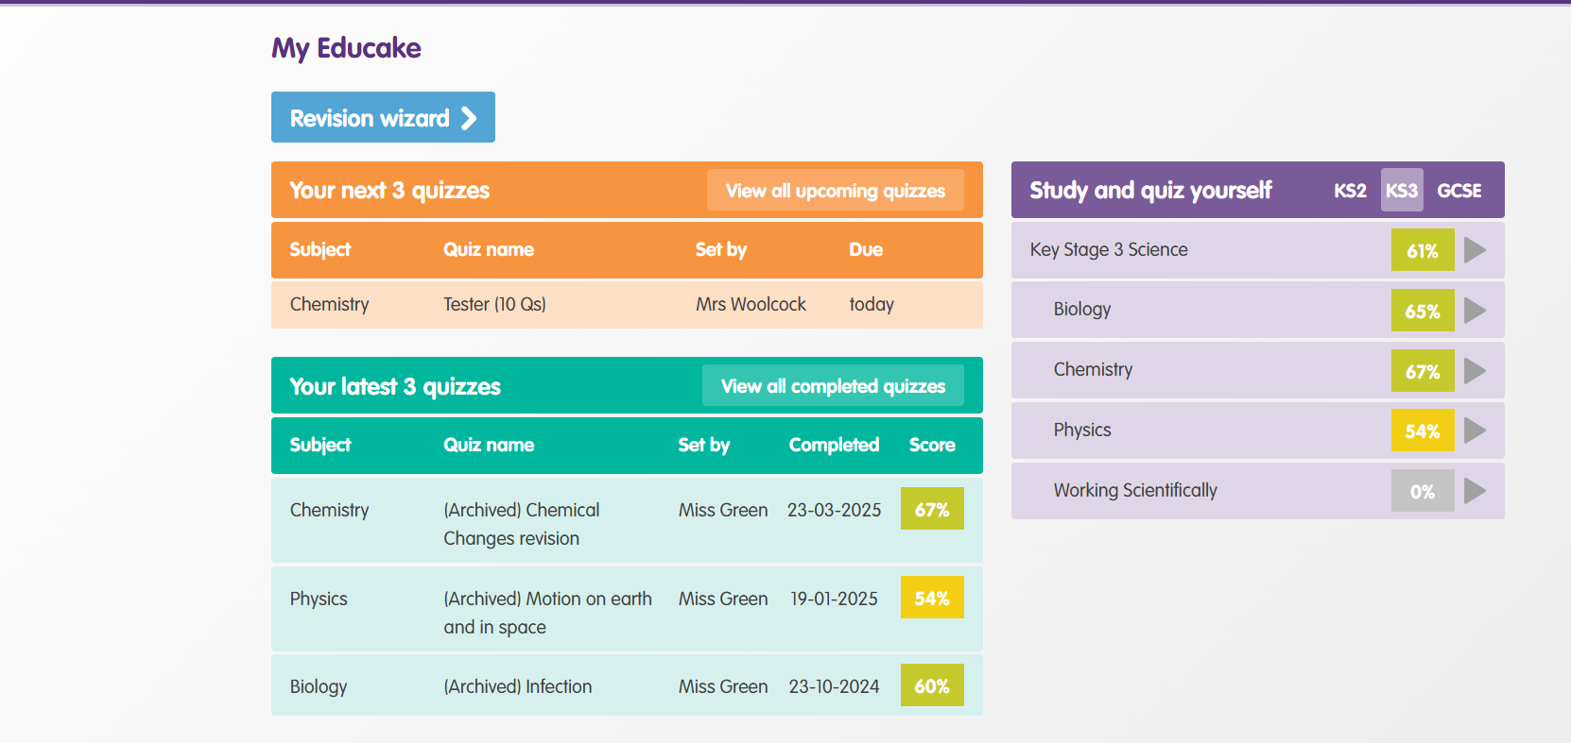
Educake
Any set quizzes will come up

Slide 29
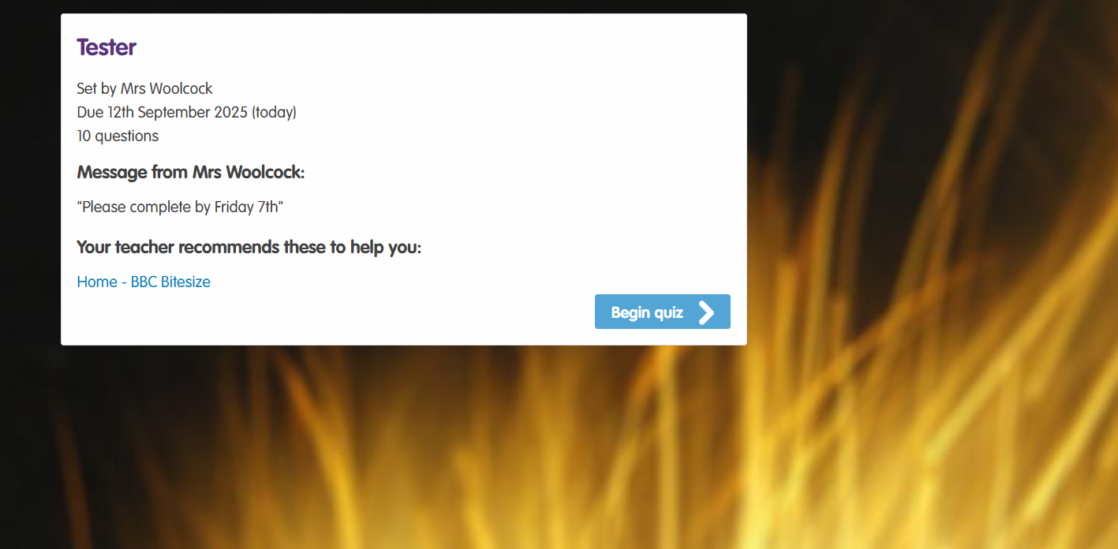
There may be added information for your son to view

Slide 30
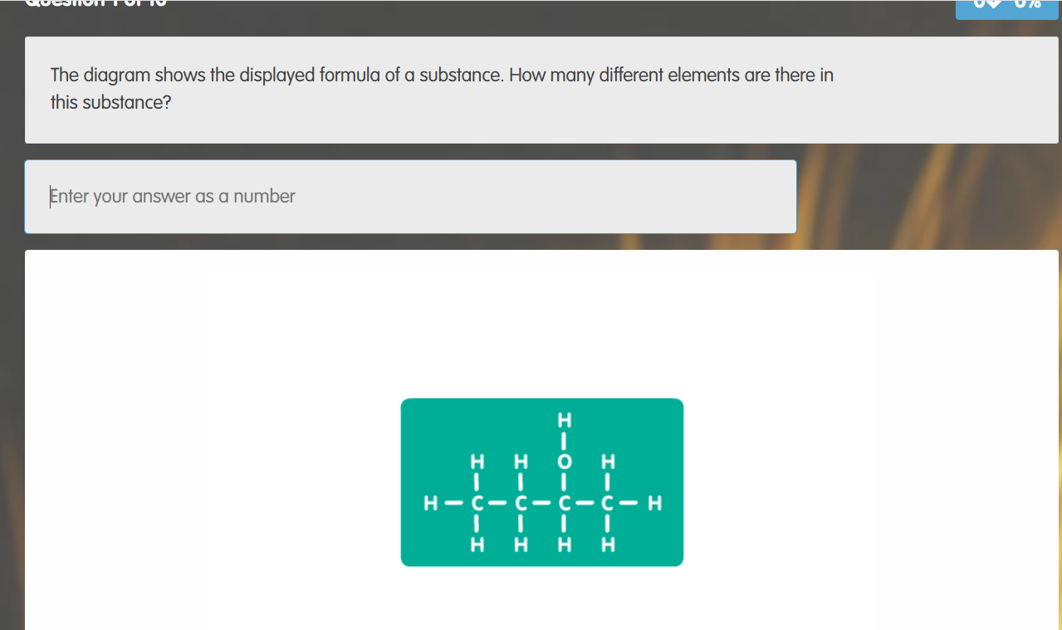
Complete the quiz and repeat until a certain % is reached eg 95% correct

Slide 31
KS3 Science
Revision Guides: I recommend CGP, they have a vast array of supporting materials www.worldofbooks.com have second hand versions which are cheaper!
We are going to be sending letters to parents this term with details how to buy CGP revision resources through school.
There will (not currently on there) be guide on Google Classroom as to which chapters in the revision guide correspond to which chapters in our textbooks.

Slide 32
Maths Year 8
Focus: Formal process and written solution (logical methodology)
The John Fisher School

Slide 33
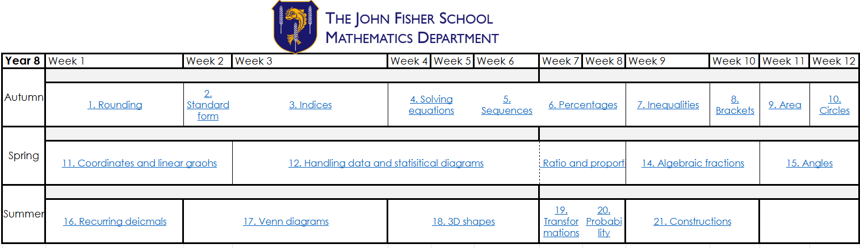
Year 8 Overview

Slide 34
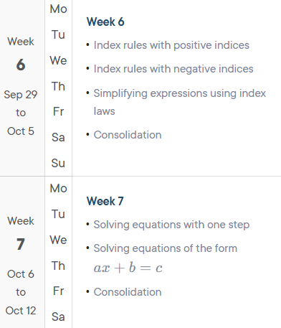
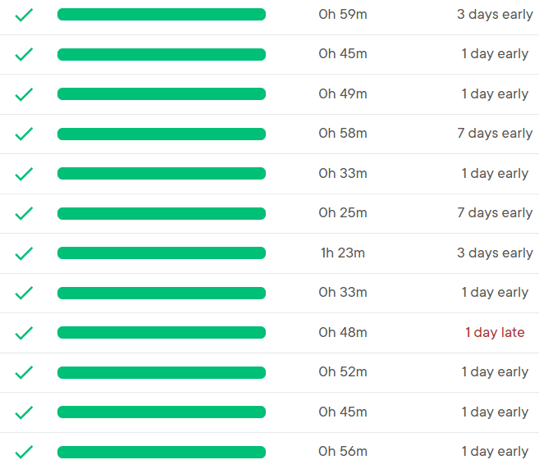
Sparx Maths
Set Wednesday
Due the following Wednesday
Copy out questions and show full workings (if they are racing through Sparx will give them more homework each week, aiming for 1 hour)
Start homework early so they can ask their teacher for help.
100% completion

Slide 35
Assessments
Mini Quiz
Informal short quiz
At the end of a topic
Completed in lesson
Self assessed / Peer assessed
WWW and EBI
Assessment
Will be written in student planners (1 week before)
Completed in lesson
Teacher assessed
QLA feedback with Sparx Codes to help progress student
Summer / EOY
Same criteria as formal assessments
Help to set them for Year 9

Slide 36
Revision
Sparx Maths
https://www.mathsgenie.co.uk/
https://corbettmaths.com/
https://www.bbc.co.uk/bitesize/subjects/z38pycw
https://www.mrbartonmaths.com/topics/

Slide 37
Religious Education
The John Fisher School

Slide 38
This half-term: Creation and Covenant
Creation and Sin – vocation of humankind and our response
God’s response to that – Baptism
Covenant at Sinai
Ways of living the covenant
Love of Neighbour
Rules, Law and Virtue
Marriage
Conscience and Conscientious Objection

Slide 39
November-Christmas: Prophecy to Promise
OT to NT – Isaiah, Jeremiah and Amos
Relevance of prophets
John the Baptist and his message
Nature of Jesus – Prophet, Priest and King
Advent

Slide 40
January-February ½ term: Galilee to Jerusalem
Kingdom of God – what it is and how it’s announced
Marginalised
Mother Teresa
Miracles
Implications of believing in miracles
Lourdes

Slide 41
End of February-Easter: Desert to Garden
Lent and its three pillars
Reconciliation
Jesus as Isaiah’s Suffering Servant
Nature of evil and suffering
As well as responses to it
Prayer
Mark’s Gospel

Slide 42
April-May ½ term: Ends of the Earth
Nature of the Resurrection
Heaven, Hell and Purgatory
Salvation – what it is and what it means to be saved
Funeral Rite
Ascension
Pentecost

Slide 43
June-July: Dialogue and Encounter
Buddhism
Three Marks of Existence and the Four Noble Truths
Forms of Buddhism
Worship
Holy Days
Karma
Meditation

Slide 44
How you can support your son
Ask him what he’s learning about
Look through his book when it comes home for homework (2 essays per half-term)
What marks has he got?
Is it well presented?
Does he know how to improve?
Is he growing in knowledge and skills?
Suggest / provide extension resources, e.g.: novels, media, news
Practice the Faith

Slide 45
English

Slide 46

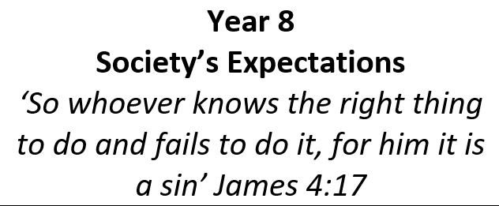
KS3 English – Year 8 Programme of Study
Miss E Johnstone
Key Stage 3 Co-ordinator for English
Mrs L. Crampton
Key Stage 4 Co-ordinator for English
Mrs S Ryder
Subject Leader for English

Slide 47



KS3 English – Year 8 Programme of Study
Autumn Term Spring Term Summer Term

Slide 48
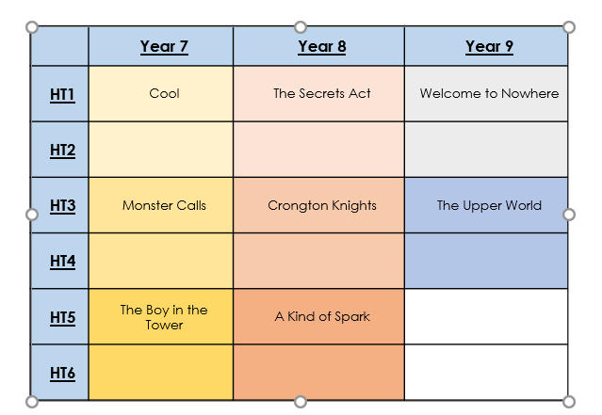
Class Readers
One lesson a fortnight is a dedicated to our class reader, each class reader is chosen to compliment our scheme of work and demonstrate how wider reading can influence our understanding of texts and instil a ‘thirst’ for reading.
When deciding upon our class readers, we wanted to satisfy two primary aims: to reflect upon issues that our students may encounter and offer a safe space for discussion. We have therefore chosen texts that both engage and challenge students’ perspectives of the world around them, but also texts that we as teachers love to teach which will instil that LOVE of reading!

Slide 49
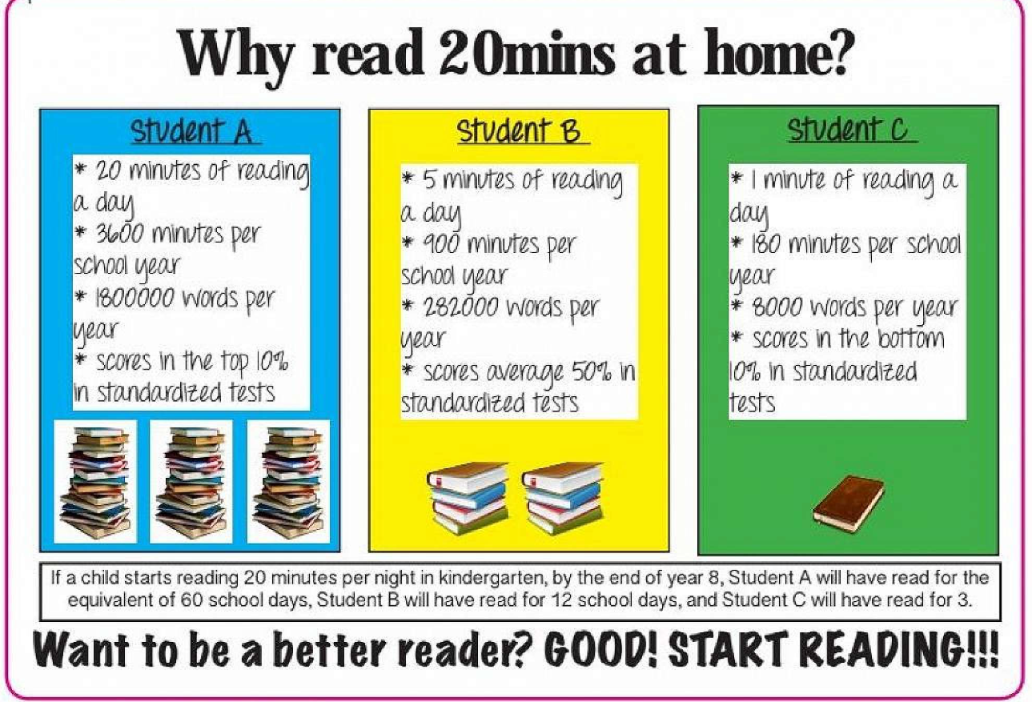
Why do we say read for 20 minutes a day?
Reading improves student understanding and analytical skills, while also enriching their vocabulary.
Reading also is proven to reduce stress, anxiety, and the chances of suffering from insomnia. Just 6 minutes of reading can reduce stress by 68%.
Reading boosts empathy, mental health and wellbeing
Reading each day is workout, similar to cardio training, for your brain.
It is never too late to become a reader, and every minute reading helps.

Slide 50
What can I do to help my son?
Discuss with your son the history around topics to link ideas together through visits to museums, galleries and even local areas. For example – the Imperial War Museum is free and would underpin and make our war fiction this year both relevant and relatable.
We cannot underestimate the power of ‘modelling’ good practices…let your son see and hear you reading little and often.
Make time to sit down and eat together once a week, all electronic devices off and talk! It makes a huge difference to the verbal skills of students. Watching the news is a great way to discuss wider cultural issues which is knowledge that can be applied to curriculum.

Slide 51
Home learning
Home learning ‘take away’ menus with differentiated tasks and expectations will be provided by each subject and shared with students early on in each term.
As home learning ‘take away’ menus feature a range of differentiated tasks to be completed during the course of a term, which is in line with the ‘Assessment, Recording and Reporting’ policy.
All homework will be given an Engagement and Ownership grade 1-5 (5 being outstanding) this is in line with their Age Related Expectations.

Slide 52
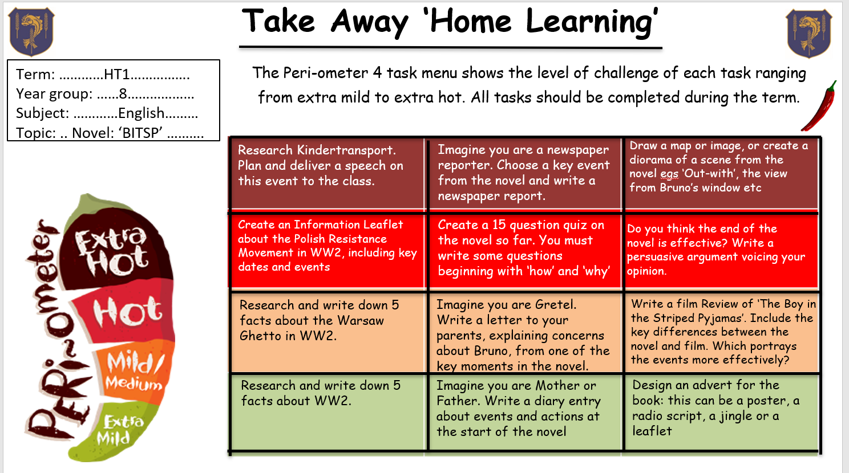
Example of Home Learning

Slide 53
Assessments
Unit assessments will consist of:
Knowledge Quizzes
Assessed on content covered over a couple of weeks / part of the Unit.
End of Unit Assessments
Assessed on the content covered in the Unit. May include sections on spelling, key terminology, literary devices, and extended writing – creative or analytical
The assessments will provide opportunities for Dedicated Improvement and Reflection Time (DIRT time)
Students will achieve a mark, which will form part of the percentage they are reported on.
They will also be given feedback on what they did well areas to improve.
Assessments are kept in school by the teacher.

Slide 54
Thank you.
Mrs Lovelock and Mr Dawkins will remain behind if you have any questions.

