Slide 1
The John Fisher School Sixth Form
Romans 2:6 God will “repay each person according to what they have done.”
Parents Information Evening
The John Fisher Sixth Form
R
ewards
espect
ights

Slide 2
The John Fisher School Sixth Form
Romans 2:6 God will “repay each person according to what they have done.”
Year 12 Key Dates:
Last chance for subject changes – 29 September
PPE 1 (exams): 4 - 8 December
PPE 2 (exams): 24 June - 5 July
IM 1 (report): Late January (TBC)
IM 2 (report): Late July (before EOY)
Head Boy Applications: Term 2 (TBC Jan – Mar)
Work Experience: July (TBC)
R
ewards
espect
ights

Slide 3
The John Fisher School Sixth Form
Romans 2:6 God will “repay each person according to what they have done.”
Year 13 Key Dates:
UCAS Application Cycle Opens: 5 September
University Admissions Test Application Deadline: 22 September
Deadline for UCAS Application for conservatoire music applications: 2 October
Deadline for UCAS Application for Deadline for applications to the universities of Oxford and Cambridge, and for most courses in medicine/ science: 16 October
Deadline for UCAS Application for most undergraduate courses: 31January
UCAS Extra Opens (chance to add 1 more choice if no offers): 5 February (closes 4 July)
PPE 1 (exams): 27 November - 8 December
PPE 2 (exams): 18 - 29 March
IM (report) 1: Late January (TBC)
IM (report) 2: Early May (TBC)
Final Exams: 13 May - 21 June* provisional and subject to change
A Level Results Day – 15 August
R
ewards
espect
ights

Slide 4
The John Fisher School Sixth Form
Romans 2:6 God will “repay each person according to what they have done.”
The John Fisher Sixth Form
The Re-Launch Vision
R
ewards
espect
ights

Slide 5
The John Fisher School Sixth Form
Romans 2:6 God will “repay each person according to what they have done.”
What did STUDENTS think about the Sixth Form Last Year?
Student Survey Results:
Average of 2.5/5 for effectiveness of systems and routines
Average of 3.4/5 for behaviour in lessons
Average of 2.6/5 for behaviour outside of lessons
“Lack of ICT, poor facilities, not given enough trust, not treated any differently to being in Yr11, not enough help outside of lessons given.”
R
ewards
espect
ights

Slide 6
The John Fisher School Sixth Form
Romans 2:6 God will “repay each person according to what they have done.”
What did STAFF think about the Sixth Form Last Year?
Staff Survey Results 2023 Review :
Average of 2.4/5 for effectiveness of systems and routines
Average of 3.1/5 for behaviour in lessons
Average of 2.0/5 for behaviour outside of lessons
“Comments on uniform and behaviour of some students in Yr13 Students' use of mobile phones around site. There are comments regarding the space available, the opportunities for developing student leadership and an absence of the House system or Reward system.”
R
ewards
espect
ights

Slide 7
The John Fisher School Sixth Form
Romans 2:6 God will “repay each person according to what they have done.”
What did the EXTERNAL REVIWER think about the Sixth Form Last Year?
Areas for Development:
There is clear pressure on facilities.
The amount and use of unstructured times has led to difficulties in areas. Clearer expectations for supported study could be developed.
Students do not have the opportunity to leave site, taking additional responsibility, and this leads to boredom.
R
ewards
espect
ights

Slide 8
The John Fisher School Sixth Form
Romans 2:6 God will “repay each person according to what they have done.”
So what are we doing about it?
Sixth Form Priorities:
Adopt a culture of Romans 2:6
Establish employer/employee relationships between staff/students
To restore trust in the effectiveness of systems and routines
R
ewards
espect
ights

Slide 9
The John Fisher School Sixth Form
Romans 2:6 God will “repay each person according to what they have done.”
Adopt a culture of Romans 2:6
Reviewed in Dec
Students Start here
Lack of Respect

Slide 10
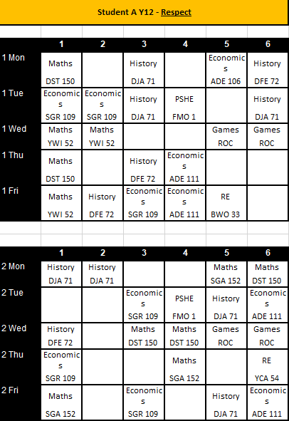
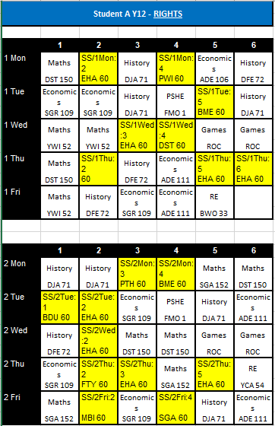
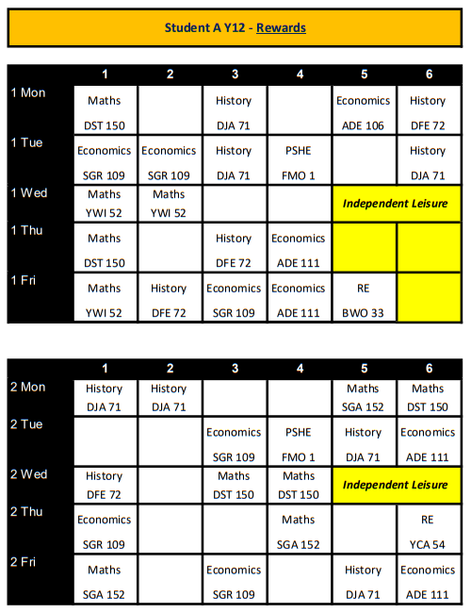
The John Fisher School Sixth Form
Romans 2:6 God will “repay each person according to what they have done.”

Slide 11
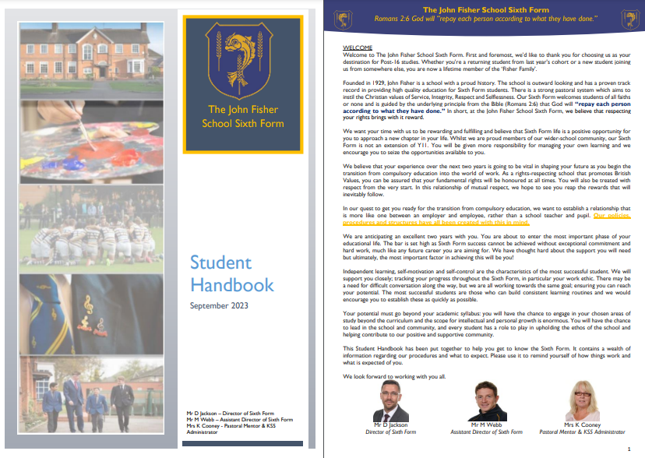
The John Fisher School Sixth Form
Romans 2:6 God will “repay each person according to what they have done.”
2) Establish employer/employee relationships between staff/students
The student handbook had been re-written to reflect new/updated policies
On page 1 the following sentence is highlighted in gold. It says:
In our quest to get you ready for the transition from compulsory education, we want to establish a relationship that is more like one between an employer and employee, rather than a school teacher and pupil. Our policies, procedures and structures have all been created with this in mind.
R
ewards
espect
ights

Slide 12
The John Fisher School Sixth Form
Romans 2:6 God will “repay each person according to what they have done.”
2) Establish employer/employee relationships between staff/students
Here are some examples of how new policies have been shaped to achieve this new relationship:

Slide 13
The John Fisher School Sixth Form
Romans 2:6 God will “repay each person according to what they have done.”
3) To restore trust in the effectiveness of systems and routines
Rights Respect Rewards
Employer/ Employee Rationale
£100K Refurb Lessons for Life Programme New Leadership

Slide 14
The John Fisher School Sixth Form
Romans 2:6 God will “repay each person according to what they have done.”
What role can parents play?
Give the us time and support
Rome wasn’t built in a day, and neither will a culture of Romans 2:6
Support the culture in student interactions
Ask your child how their studies are going in relation to their own targets. Ask them what they’re doing to support their application for the next “rewards” review. Ask them how many periods they spent in the Silent Study Area and/or Common Room.
Know your child’s level
If you know your child is not on rewards level, then please challenge them as to why they’re home before 3pm.
Sixth Form

Slide 15
R
The John Fisher School Sixth Form
Romans 2:6 God will “repay each person according to what they have done.”
ewards
espect
ights
We look forward to watching your child succeed.

Slide 16
The John Fisher School Sixth Form
Romans 2:6 God will “repay each person according to what they have done.”
The John Fisher Sixth Form
UCAS Predicted Grades Revision-Request Policy
R
ewards
espect
ights

Slide 17
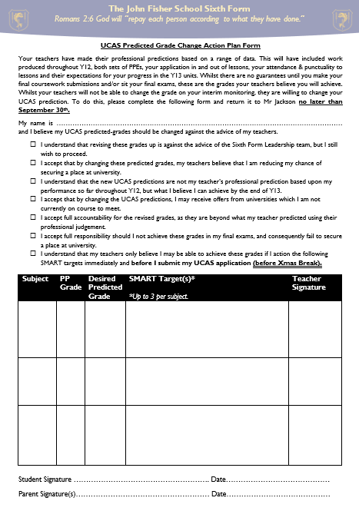
The John Fisher School Sixth Form
Romans 2:6 God will “repay each person according to what they have done.”
Can UCAS Predicted Grades be Changed?
YES, but…
This must be actioned by the end of this month
No options to change after that
Strike a balance between students best interests and protecting the professional reputation of JFS
Students must complete this form
Can be downloaded from Google Classroom
Targets must be agreed by end of September
Actions must be evidenced by end of December

Slide 18
The John Fisher School Sixth Form
Romans 2:6 God will “repay each person according to what they have done.”
Text:
Your teachers have made their professional predictions based on a range of data. This will have included work produced throughout Yr12, both sets of PPEs, your application in and out of lessons, your attendance & punctuality to lessons and their expectations for your progress in the Yr13 units. Whilst there are no guarantees until you make your final coursework submissions and/or sit your final exams, these are the grades your teachers believe you will achieve. Whilst your teachers will not be able to change the grade on your interim monitoring, they are willing to change your UCAS prediction. To do this, please complete the following form and return it to Mr Jackson no later than 30 September.

Slide 19
The John Fisher School Sixth Form
Romans 2:6 God will “repay each person according to what they have done.”
Text:
My name is …and I believe my UCAS predicted-grades should be changed against the advice of my teachers.
I understand that revising these grades up is against the advice of the Sixth Form Leadership team, but I still wish to proceed.
I accept that by changing these predicted grades, my teachers believe that I am reducing my chance of securing a place at university.
I understand that the new UCAS predictions are not my teacher’s professional prediction based upon my performance so far throughout Yr12, but what I believe I can achieve by the end of Yr13.

Slide 20
The John Fisher School Sixth Form
Romans 2:6 God will “repay each person according to what they have done.”
Text:
I accept that by changing the UCAS predictions, I may receive offers from universities which I am not currently on course to meet.
I accept full accountability for the revised grades, as they are beyond what my teacher predicted using their professional judgement.
I accept full responsibility should I not achieve these grades in my final exams, and consequently fail to secure a place at university.
I understand that my teachers only believe I may be able to achieve these grades if I action the following SMART targets immediately and before I submit my UCAS application (before Xmas Break).

Slide 21
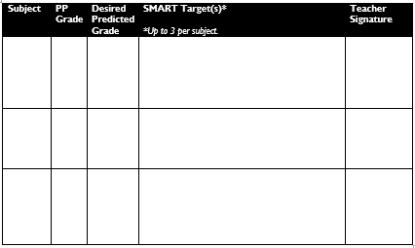
The John Fisher School Sixth Form
Romans 2:6 God will “repay each person according to what they have done.”

